Slide 1
Urban settlements
Urban Settlements 1.6
How cities work
Describe and give reasons for the characteristics of and changes in, land use in urban areas
Explain the problems of urban areas, their causes and possible solutions
Notes:
<number>

Slide 2
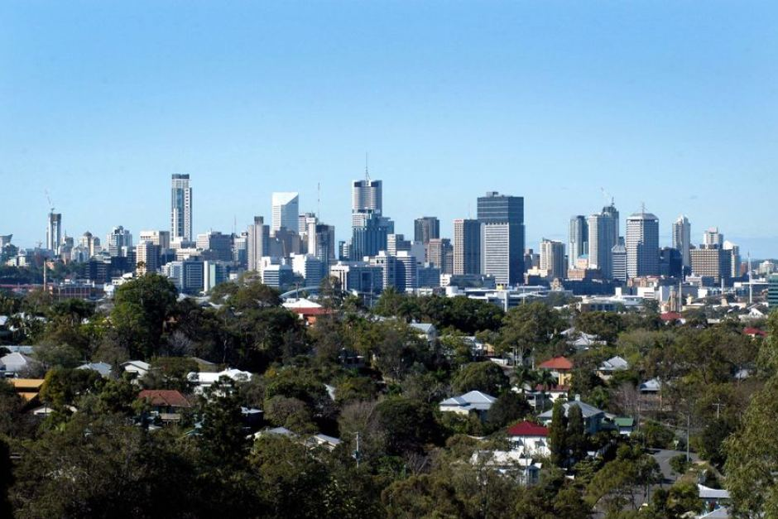
You are going to draw a city scape. Describe what you would see to your partner based on the image and they have to draw it on their white board.
What do you notice about the buildings in this image?
Where is the centre of the city?
What type of buildings are there? Why do you think that is?
Which area do you think would be most expensive to buy a house in? Why?
Imagine you are in the centre of this city and you walk all the way out to the suburbs in a straight line. If you were to do this and sketch the buildings that you pass along the way you would have created a transect of the city. Transects help us to identify the different land use zones of a city. Take a virtual walk through here
Drawing challenge.
Brisbane city, Australia

Slide 3
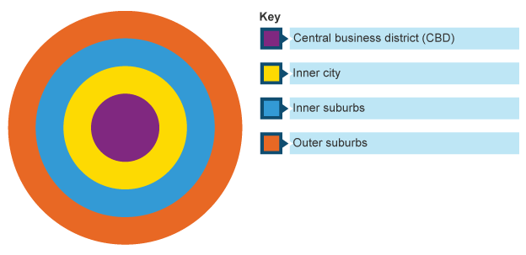
Urban land use – what are cities like?
Land use simply means what the land is used for. Land use models try to show patterns in how the land in an area is used.
The Burgess model was used to show how cities in the 19th and 20th century were set out; the pattern of how the land was used.
Draw and label your own copy of the Burgess model.

Slide 4
Look at the Burgess Model below. Can you guess the types of buildings and services you might find in each zone? Annotate your diagram to show the types of buildings found in each zone.

Slide 7
How do CBD’s develop?
Often it starts as the original growth point of the settlement, the old village centre.
This is also the point where transport routes connect and therefore a good location for retail business and trade.
As businesses and services locate there, demand for land in this central area increases, this leads to an increase in land prices meaning that only certain services ( often high order services) can afford to locate there. High land prices lead to buildings getting taller and taller to make the best use of the expensive and limited land.

Slide 8
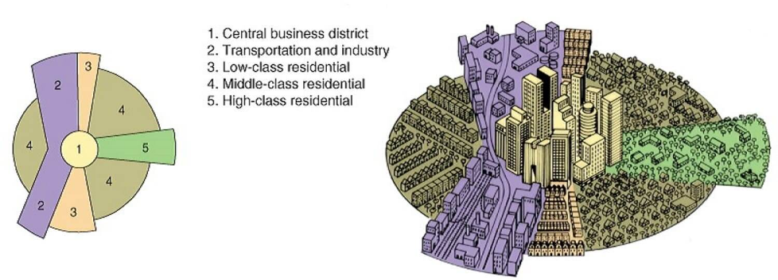
Homer Hoyt’s sector model.
Make a copy in your notes. How does it compare to the Burgess model? What are the main differences?
Add a Slide Title - 4
Hoyt wanted to show the importance of transport routes and how they influence the use of the land around them.
Can you see where the different types of housing are? Why do you think this is?

Slide 9
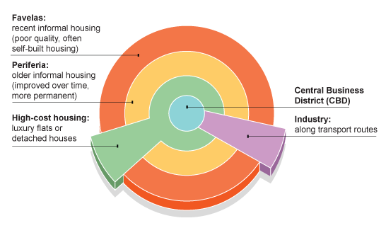
Urban land use in LEDCs
This is a model of land use in urban areas in less developed countries.
What differences do you notice in the land use when compared to the MEDC model?

Slide 10
Land use models: useful but not perfect...
Land use models like Burgess and Hoyt’s can help us understand how urban areas develop. They map the land use zones, each zone having one or more important urban function – commercial, industrial, residential etc.. They also show facilities such as roads and schools which form the settlements infrastructure.
The burgess model suggests that every area or zone has grown at the same rate in every direction. Hoyt’s model is more realistic as different zones may grow at different rates. It also allows for the impact the infrastructure has on the cities development.
Urban areas today do not fit well into these models because old inner city areas are often redeveloped and their functions changed as part of regeneration projects.
New transport routes are built which by-pass the centre of towns leading industry to locate on the urban fringe.
The oldest part of a city is not always the centre.

Slide 11
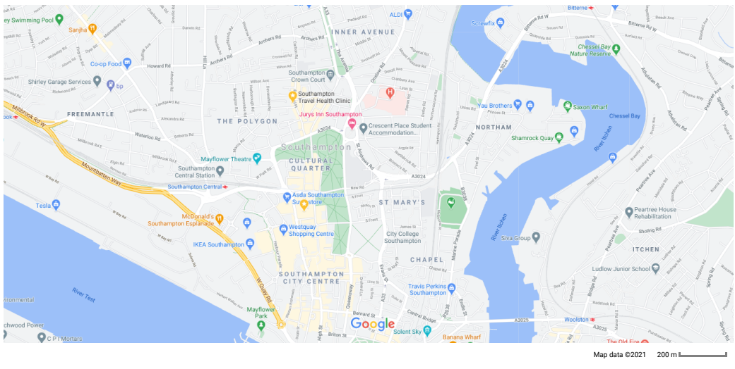
Land use models: useful but not perfect...
Try to fit one of the models to Southampton using the map below, does it fit well? If not what differences do you notice? If you want a closer look, walk from the centre of the city out using street view on google maps: here.

Slide 12
Urban change and regeneration

Slide 13
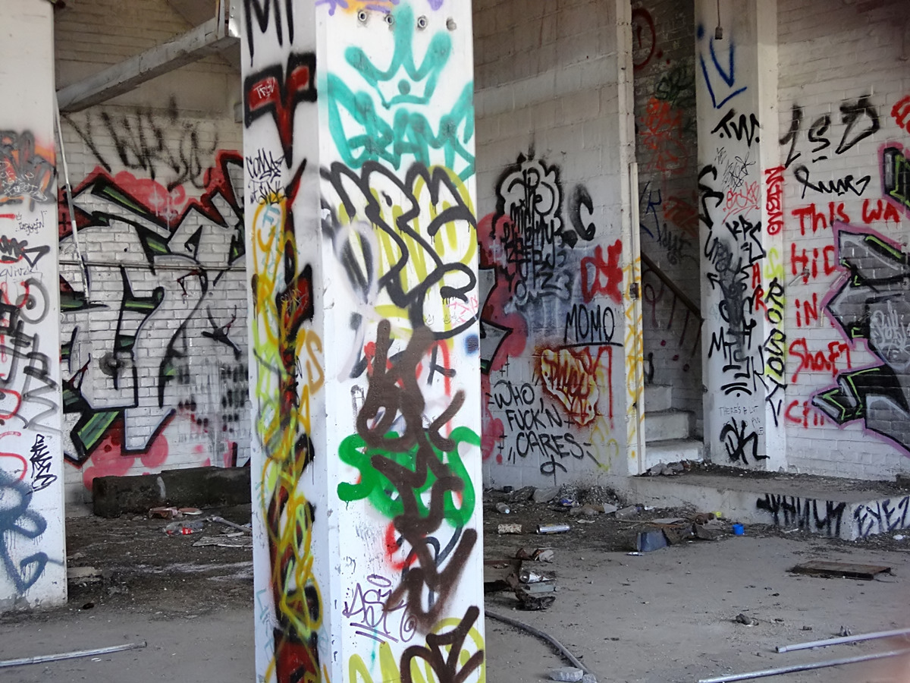
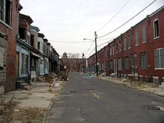
The quality of life of residents can suffer due to these problems leading to movement out of the city – urban to rural migration, inner city decline and urban decay.
Signs of urban decay include buildings in disrepair, vandalism and derelict land.
Problems of urban areas
As cities grow they can become difficult places to live due to the pressures of overcrowding as the population increases. Governments and locals councils must work hard to provide housing, services, transport and jobs for the growing number of people. When growth of cities has been very rapid this has proved too difficult to cope with in many urban areas leading to serious problems of pollution, inequality, traffic congestion and crime.

Slide 14
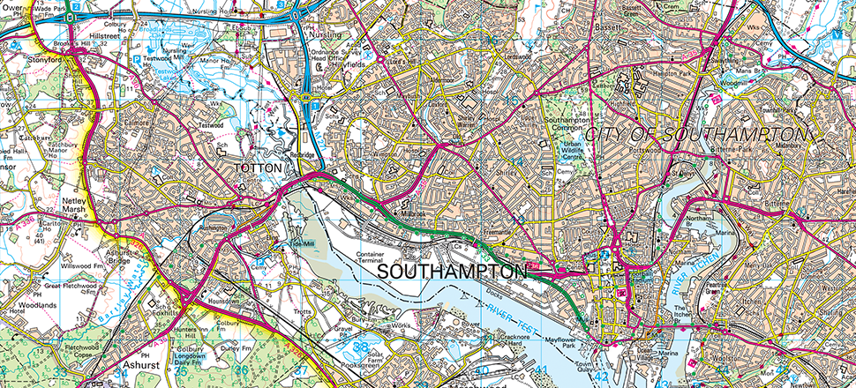
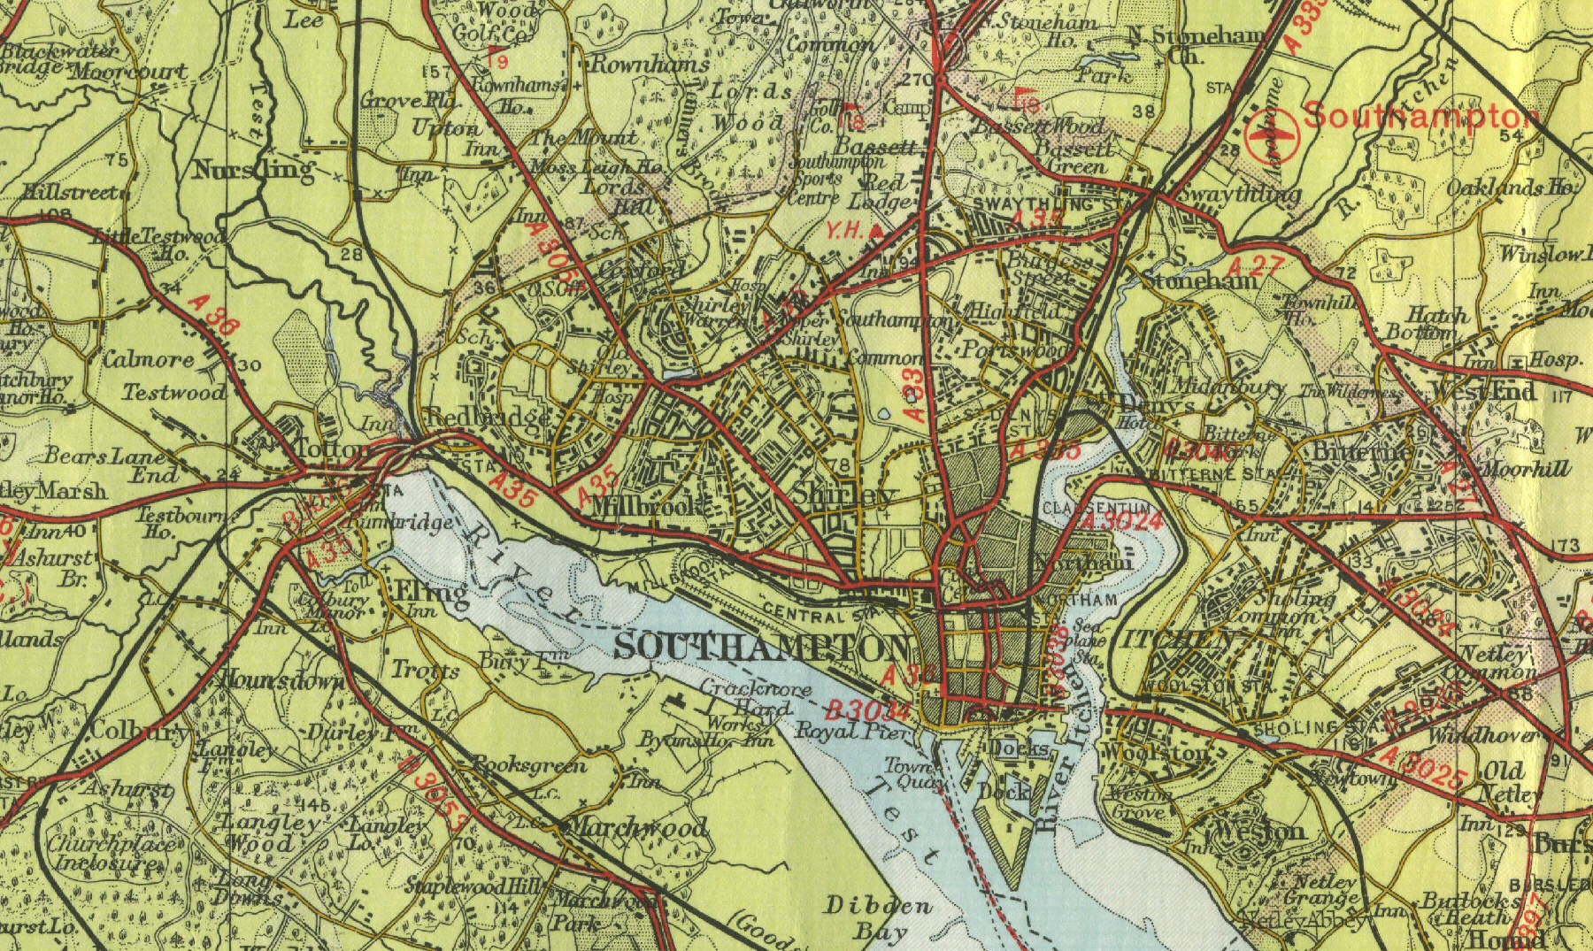
Problems of urban sprawl
Comparing these maps of Southampton show urban sprawl.
What problems do you think may result from this expansion into the countryside?
Find an old map of your nearest city and compare it to a recent map.

Slide 15
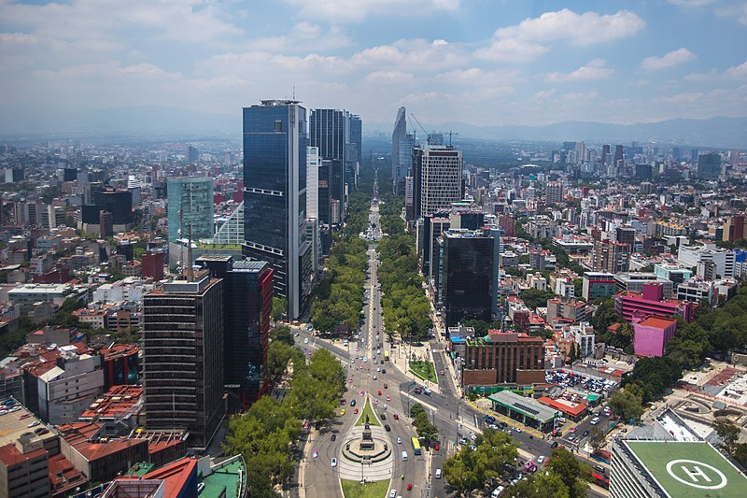
Problems of urban areas
Urban sprawl caused by rapid urban growth leads to many problems because often city planners do not have the time to modify the area and plan for the changes that are taking place.
Urban Sprawl in NEE (Newly Emerging Economies) countries causes many problems.
Watch this video about Urban Sprawl in Mexico City, Mexico South America. As you watch take note of the problems faced by the city and the causes of the problem. This is a case study for the problems of urban change. Now completethis lesson video on Urban growth problems in Lagos, Nigeria Africa.
Can you think of solutions you have seen in your cities to some of these problems?

Slide 16
Problems of urban areas
Sort these problems as well as any other you have thought of into the categorise: Social, Economic and Environmental.
Congestion and poor accessibility
Lack of parking
High land prices
Retailers leaving due to high costs in CBD - leaves derelict buildings
Decentralisation of companies and offices to green belt areas
High mobility of consumers (increase car ownership).
Urban sprawl means CBD’s are often many miles from residential areas.
Increase in pollution – noise, air, water and visual.
Conflict within communities as land use changes due to urban sprawl.
Security in the CBD:
High crime rates due to unemployment
Litter
Graffiti
Derelict land and buildings
Social problems
High levels of poverty
Racial conflict
(informal housing in LEDC’s)

Slide 17
Problems of urban areas
You saw in your Southampton case study for the settlement unit that areas of the city had undergone redevelopment to counter act some of these problems. Read the articles again and make notes on the problems and the solutions the local government have found.
Here are the articles again:
Southampton regeneration
Southampton in the spotlight
Waterfront revamp
CBD redevelopment
Here are some new articles to read through.
Exit point to place to stay
Regeneration scheme housing
Redevelopment of brownfield site and this one Wind turbine factory
Conflict due to redevelopment

Slide 18
Some solutions to the problems of urban areas
Here are some other case studies – follow the links and make notes on how different cities have tried to tackle different problems, and how successful they have been.
Congestion and poor accessibility:
Park and ride schemes – link to news report on park and ride in Birmingham
Improved public transport: website Curitiba Brazil
Bike hire scheme – Barclay Bikes (London) Video
Congestion zone – extra fee to drive in CBD (London). video
Retailers leaving due to high costs in CBD - leaves derelict buildings – Regeneration projects – Birmingham- current and future projects website and video: further details of past projects read here: Big City Plan.

Slide 19
Rapid urban growth
Growth changes the CBD but also has major impacts on the rural-urban fringe, where the city meets the countryside.
Urban sprawl is the term given to the process of an urban area expanding to accommodate its growing population.
This occurs because people have greater mobility, improved transport links, more disposable income to spend on recreation, longer holidays and the draw of the rural idyll = counter-urbanisation.
The rural-urban fringe provides the ideal location for golf courses, power stations, retail parks, supermarkets.
Green belts are used to try and control urban sprawl by putting legal limits on new developments in these fringe areas.

Slide 20
Counter-urbanisation
Causes of counter-urbanisation:
Overcrowding and pollution in inner city areas
Improved transport links means people can commute to work
Improved telecommunication links mean that people can work from home
Increased car ownership
Growth of out of town shopping retail centres.
The movement of people from urban to rural areas.
Took place in MEDCs from the 1980’s onwards.

Slide 21
Conflict
The change in land use at the rural-urban fringe can be a cause of conflict. New developments can cause pollution, the increase in people and traffic in an area can cause congestion and put a strain on other services.
Different land uses are often in conflict with each other – retail/recreation would be in conflict with industrial land use.
Pollution types: Visual, Air, Noise and Water.
Local councils have to try and balance the pros and cons of developments when deciding whether or not to give planning permission.
We saw some conflict in the Southampton projects where councils were encouraging new industry but local residences were in dispute. Also in the water front projects there were conflicts over access to rivers for locals.

Slide 22
Urban change case study: London
Use the frame work on the next page and the links below to create a case study sheet for Urban regeneration. This will be another useful case study.
BBC Bite size
Cool geography - click on the London links on this site
https://www.latitudegeography.org/london-case-study.html
Video(old but still ok) on the docklands redevelopment

Slide 23
Case study frame work
Location
Background information
Changes planned or carried out
Causes/problems – why were these changes needed.
Local Impacts – Long term and short term impacts of the changes.
Wider impacts – national or even international impacts of the changes made. Again look at the long term and short term.
Response – are people happy or disappointed with the outcomes? Consider locals, government, varying ages groups etc. Finally add a paragraph giving your opinion/evaluation of the project.

